Slide 1
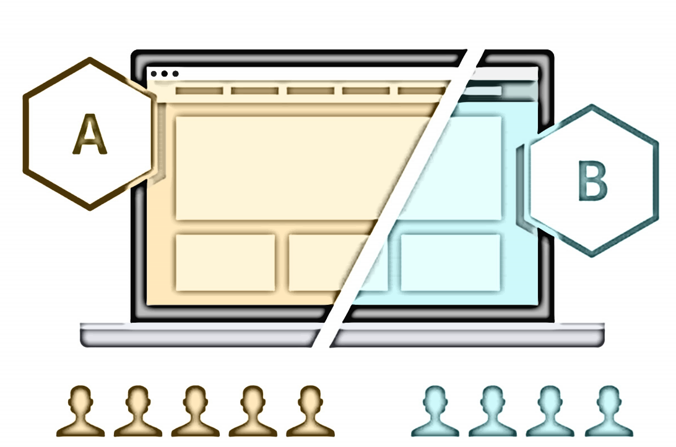
Problem Statement
E- News Express Project
The company wishes to increase client acquisition in terms of new subscribers. Based on their behaviors, businesses wish to study website hits and their patterns of interest. The company want to add a new functionality to its website. By evaluating customer reactions, the company hopes to discover the most successful two variations.
This is known as a/b testing, and it is used to identify whether a new feature attracts users based on a certain statistic.
In summary, the organization need information regarding client visits on the new landing page, which is more effective or not. Also, The amount of time a person spends on a website is really important for increasing the number of subscribers?

Slide 2
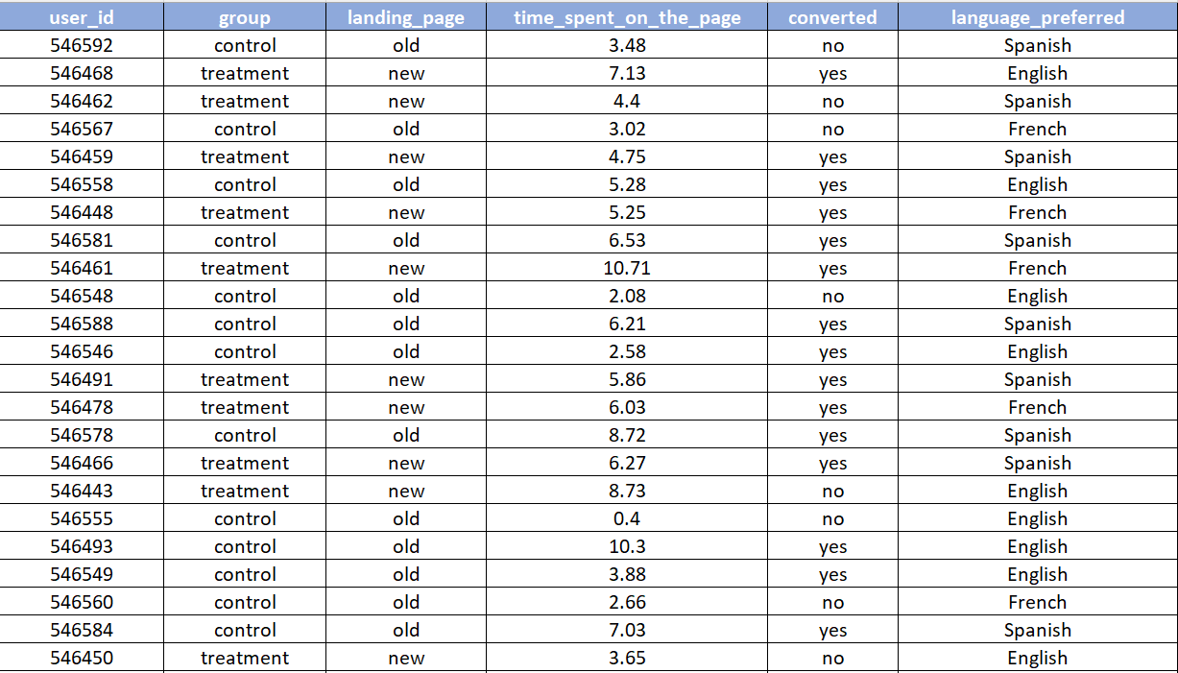
DATASET INFORMATION
Given Dataset Information
(abtest.csv)
01
USER ID
02
GROUP
03
LANDING PAGE
04
TIME SPENT ON PAGE
05
CONVERTED
Total Entries: 100 Users
06
LANGUAGE PREFERRED
Objective: Using Hypothesis Testing, determine whether a new landing page is effective in attracting new subscribers.

Slide 3
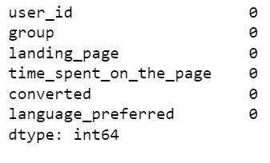
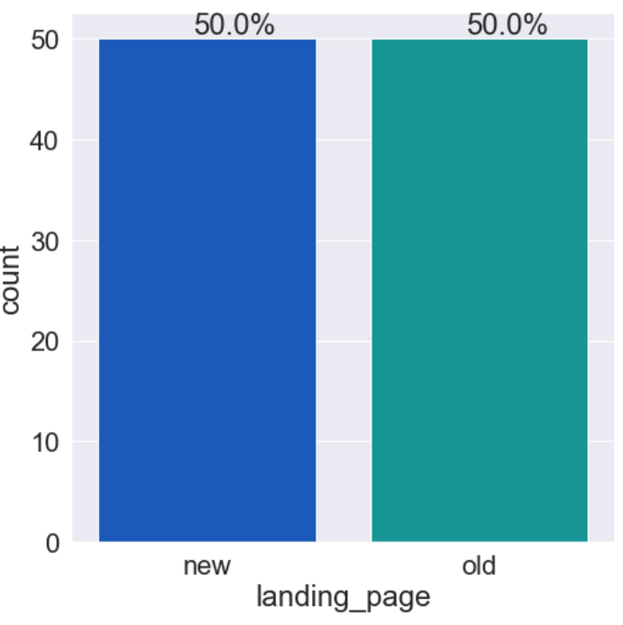
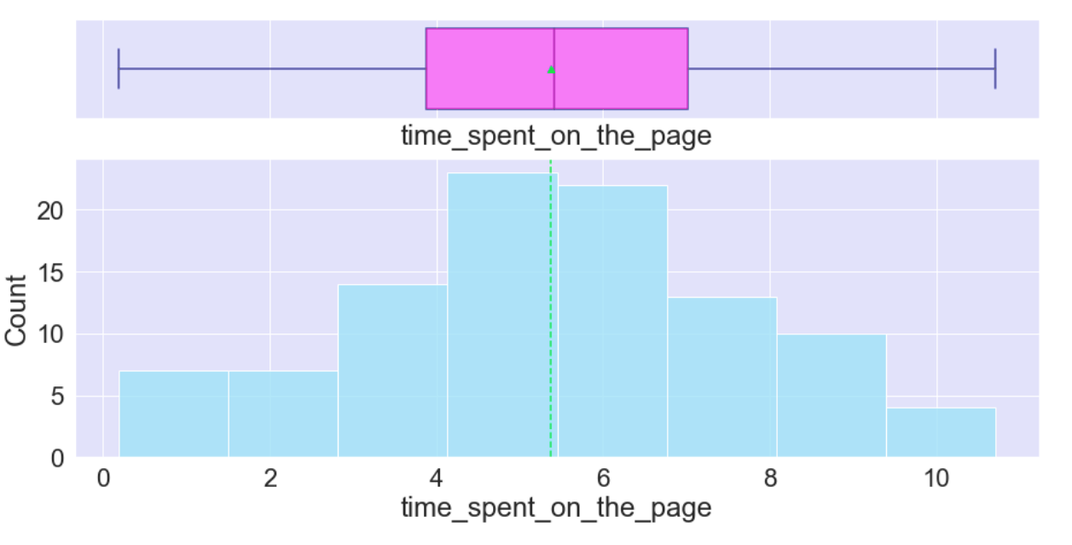
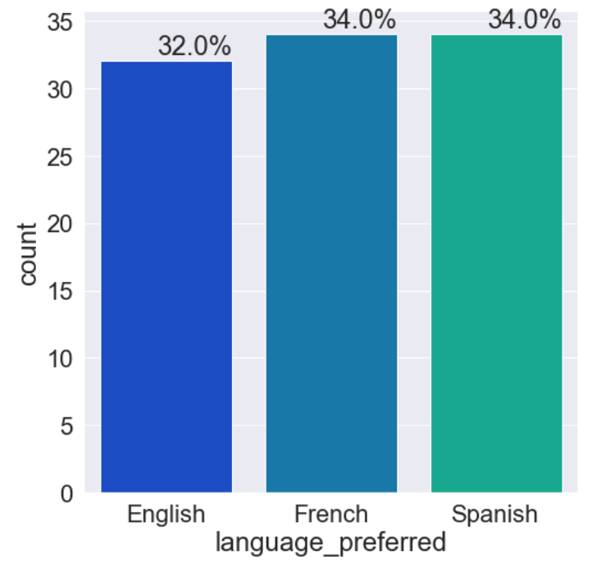
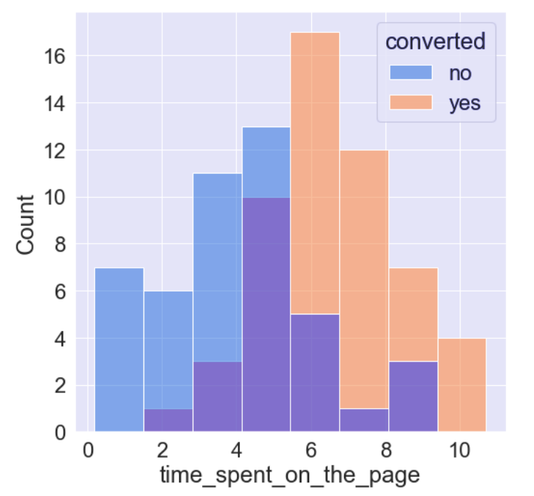
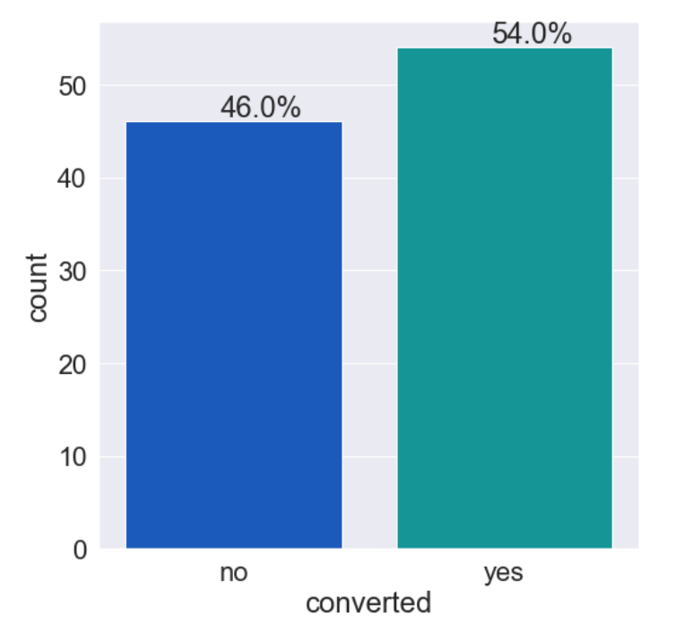
0
02
Exploratory Data Analysis
No Missing Values
Same Data given for LP users.
Max time spend on LP < 11 Minutes.
54% users are converted to new subscribers.
Preferred language is almost equal
More time is spent on new page

Slide 4
Hypothesis Testing
Do the users spend more time on the new landing page than the existing landing page?
01.
02.
Is the conversion rate for the new page greater than the conversion rate for the old page?
03.
Does the converted status depend on the preferred language?
04.
Is the time spent on the new page same for the different language users?

Slide 5
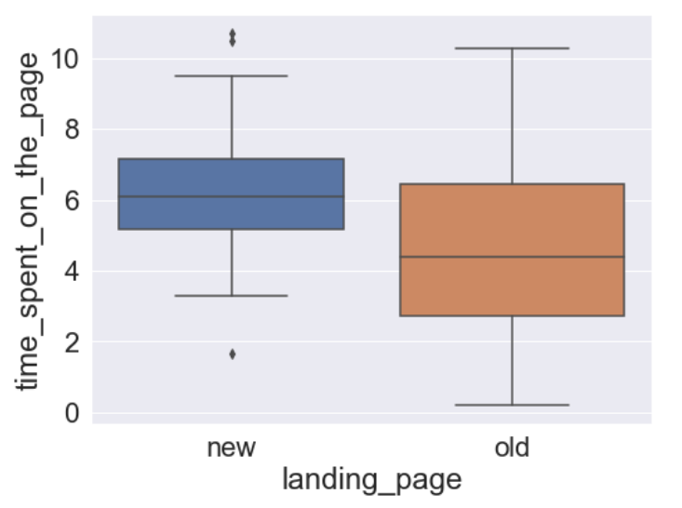
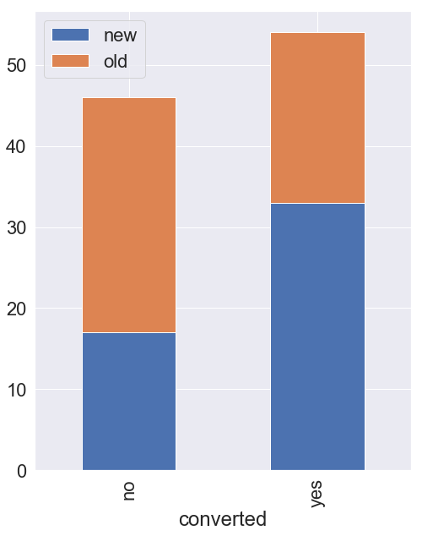
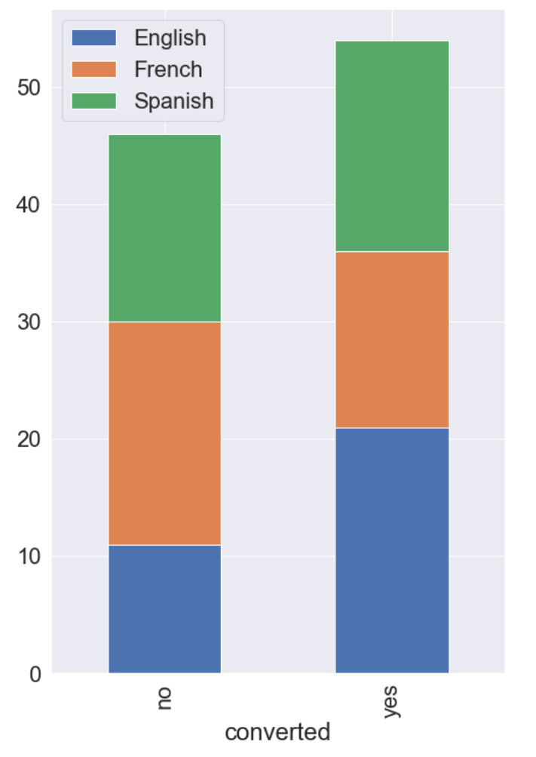
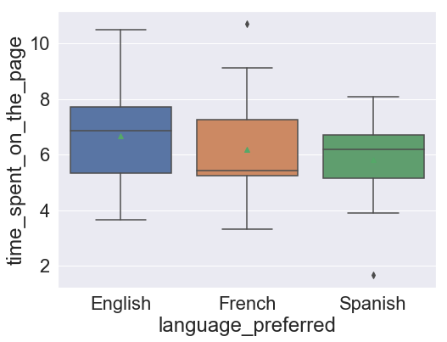
Inferences
01
We have enough statistical data to verify that the average time spent on the new page is greater than previous page.
New page converts more people than the previous page, there's enough statistical data to show that the new page has a higher conversion rate.
02
The conversion status distribution for different language users is not consistent but there is no impact of language spoken to the landing page.
03
04
To conclude the average time spent on the new page by English, French, and Spanish users is the same.
Conclusion
Company should utilize the redesigned landing page to gain additional subscribers.
The longer a visitor stays on a website, the more probable it is that he or she will convert the subscriber count.

Slide 6
That's a wrap!

